Slide 1
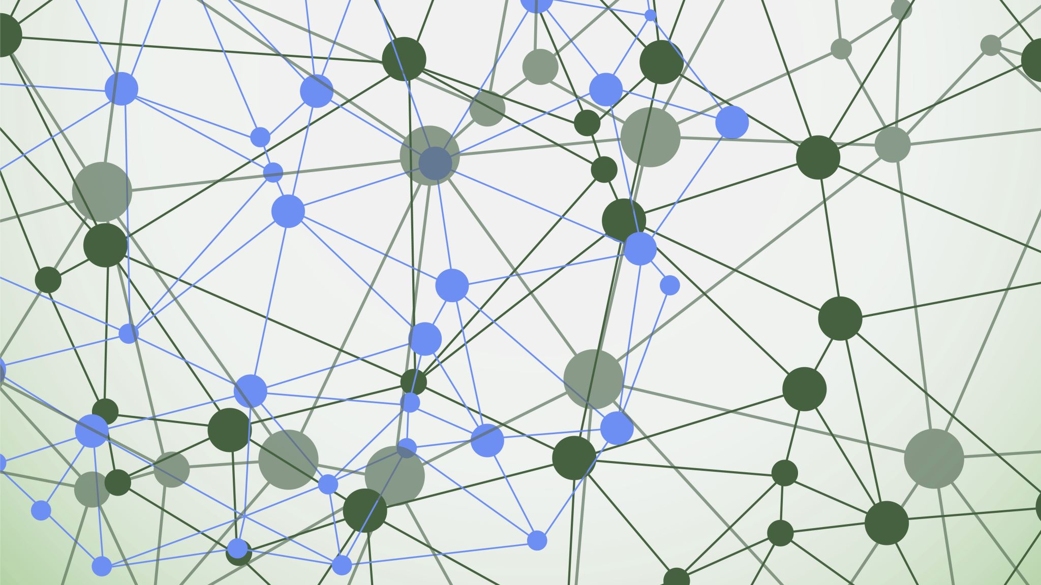
Ch.23 Digestive system
Biol 2402 Exam 1
*class material may be different or more/less in-depth.*
*DO NOT RELY ON POWERPOINT FOR MAIN STUDY REFERENCE*

Slide 2
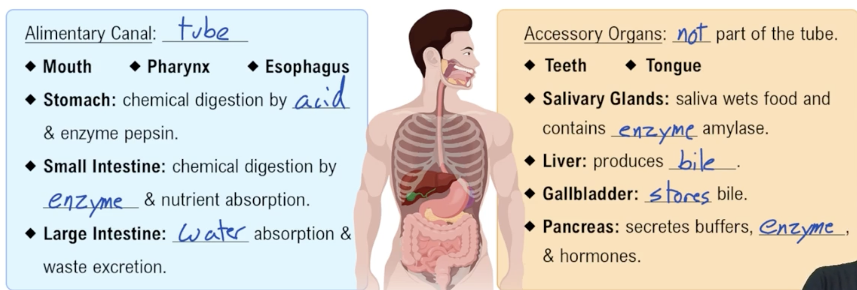
Intro to Digestive System
(GI)* =Gastrointesinal
The digestive system is broken into two different parts-
The Alimentary Canal, also known as the (GI)* tract- The muscular tube of organs
The Accessory organs – Aid in digestion and metabolism

Slide 3
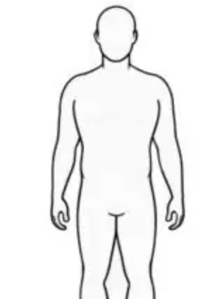
Alimentary Canal
When you think of the Alimentary Canal or GI tract, I want you to think of a Long PVC pipe going from the mouth to the anus.
This pipe has a hollow middle and anything inside this pipe is not in the body.
Therefore, any food that you consume in the Alimentary Canal is not inside the body.
The GI tract uses extracellular digestion which means that the process of digestion occurs outside the cells and in the Alimentary canal.
=

Slide 4
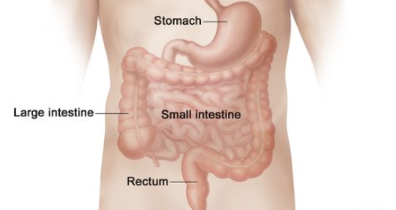
Alimentary Canal Components
The Mouth portion of the Alimentary Canal Consists of-
Mouth- entry for food and water
Pharynx- area after mouth but before epiglottis (the throat)
Esophagus- the area of the tube from the epiglottis to the stomach
The Abdomen portion of the Alimentary canal consists of-
Stomach- Chemical digestion by acid and enzyme pepsin
Small Intestine- Chemical digestion by enzymes and nutrient absorption
Large intestine- water absorption and waste secretion

Slide 5
Accessory organs
* Will be important
Not part of the Big Tube (PVC Pipe)
DOES NOT directly interact with anything inside the TUBE
Aids in digestion and metabolism
Consists of
Teeth
Tongue
Salivary Glands*
Liver*
Gallbladder
Pancreas*

Slide 6
Functions of the Digestive System
Processing of food involves six essential activities:
﻿﻿﻿Ingestion: eating
﻿﻿Propulsion: movement of food through the alimentary canal, which includes
Swallowing
﻿﻿Peristalsis: major means of propulsion of food that involves alternating waves of contraction and relaxation
Mechanical breakdown: includes chewing, mixing food with saliva, churning food in stomach, and segmentation
Segmentation: local constriction of the intestine that mixes food with digestive juices
﻿﻿﻿Digestion: series of catabolic steps that involves enzymes that break down complex food molecules into chemical building blocks
﻿﻿﻿Absorption: passage of digested fragments from lumen of GI tract into blood or lymph
﻿﻿﻿Defecation: elimination of indigestible substances via anus in form of feces

Slide 7
Function Diagram

Slide 8
Name of nutrient process in GI Tract
Bolus-
Bolus means the same thing as a single dose, so if I took a bite of a sandwich, I would have consumed one bolus of that sandwich.
Lump of chewed food mixed with saliva primarily located in the mouth and esophagus.
Chyme-
Partially Digested food mixed with Gastric Juices, Pancreatic juices, Bile, and intestinal juices.
Primary located in the Stomach and Large intestine
Feces
Fully digested waste with a low water content
Found in large intestine to the anus

Slide 9
Peritoneum
The peritoneum is a serous membrane in the abdomen that lines all of its organs and body cavity.
The membrane is serous which means it's fluid-filled and has an inner lining and and outer lining.
The peritoneum has 2 parts
The visceral peritoneum (inner lining) which lines all of the organs in the cavity
The parietal* peritoneum (outer lining) is the membrane lining the cavity wall
*(parietal means wall)

Slide 10
Histology of the Alimentary Canal
Mucosa
﻿﻿Tunic layer that lines lumen
﻿﻿Functions: different layers perform one or all three
﻿﻿Secretes mucus, digestive enzymes, and hormones
Absorbs end products of digestion
Protects against infectious disease
-﻿﻿- Made up of three sublayers
﻿﻿Epithelium
﻿﻿Lamina propria
﻿﻿ Muscularis mucosae

Slide 11
Histology part 2
2. Submucosa
﻿﻿Consists of areolar connective tissue
﻿﻿Contains blood and lymphatic vessels, lymphoid follicles, and submucosal nerve plexus that supply surrounding GI tract tissues
﻿﻿Has abundant amount of elastic tissues that help organs to regain shape after storing large meal
3. Muscularis externa
﻿﻿Muscle layer responsible for segmentation and peristalsis
﻿﻿Contains inner circular muscle layer and outer longitudinal layers
Circular layer thickens in some areas to form sphincters

Slide 12
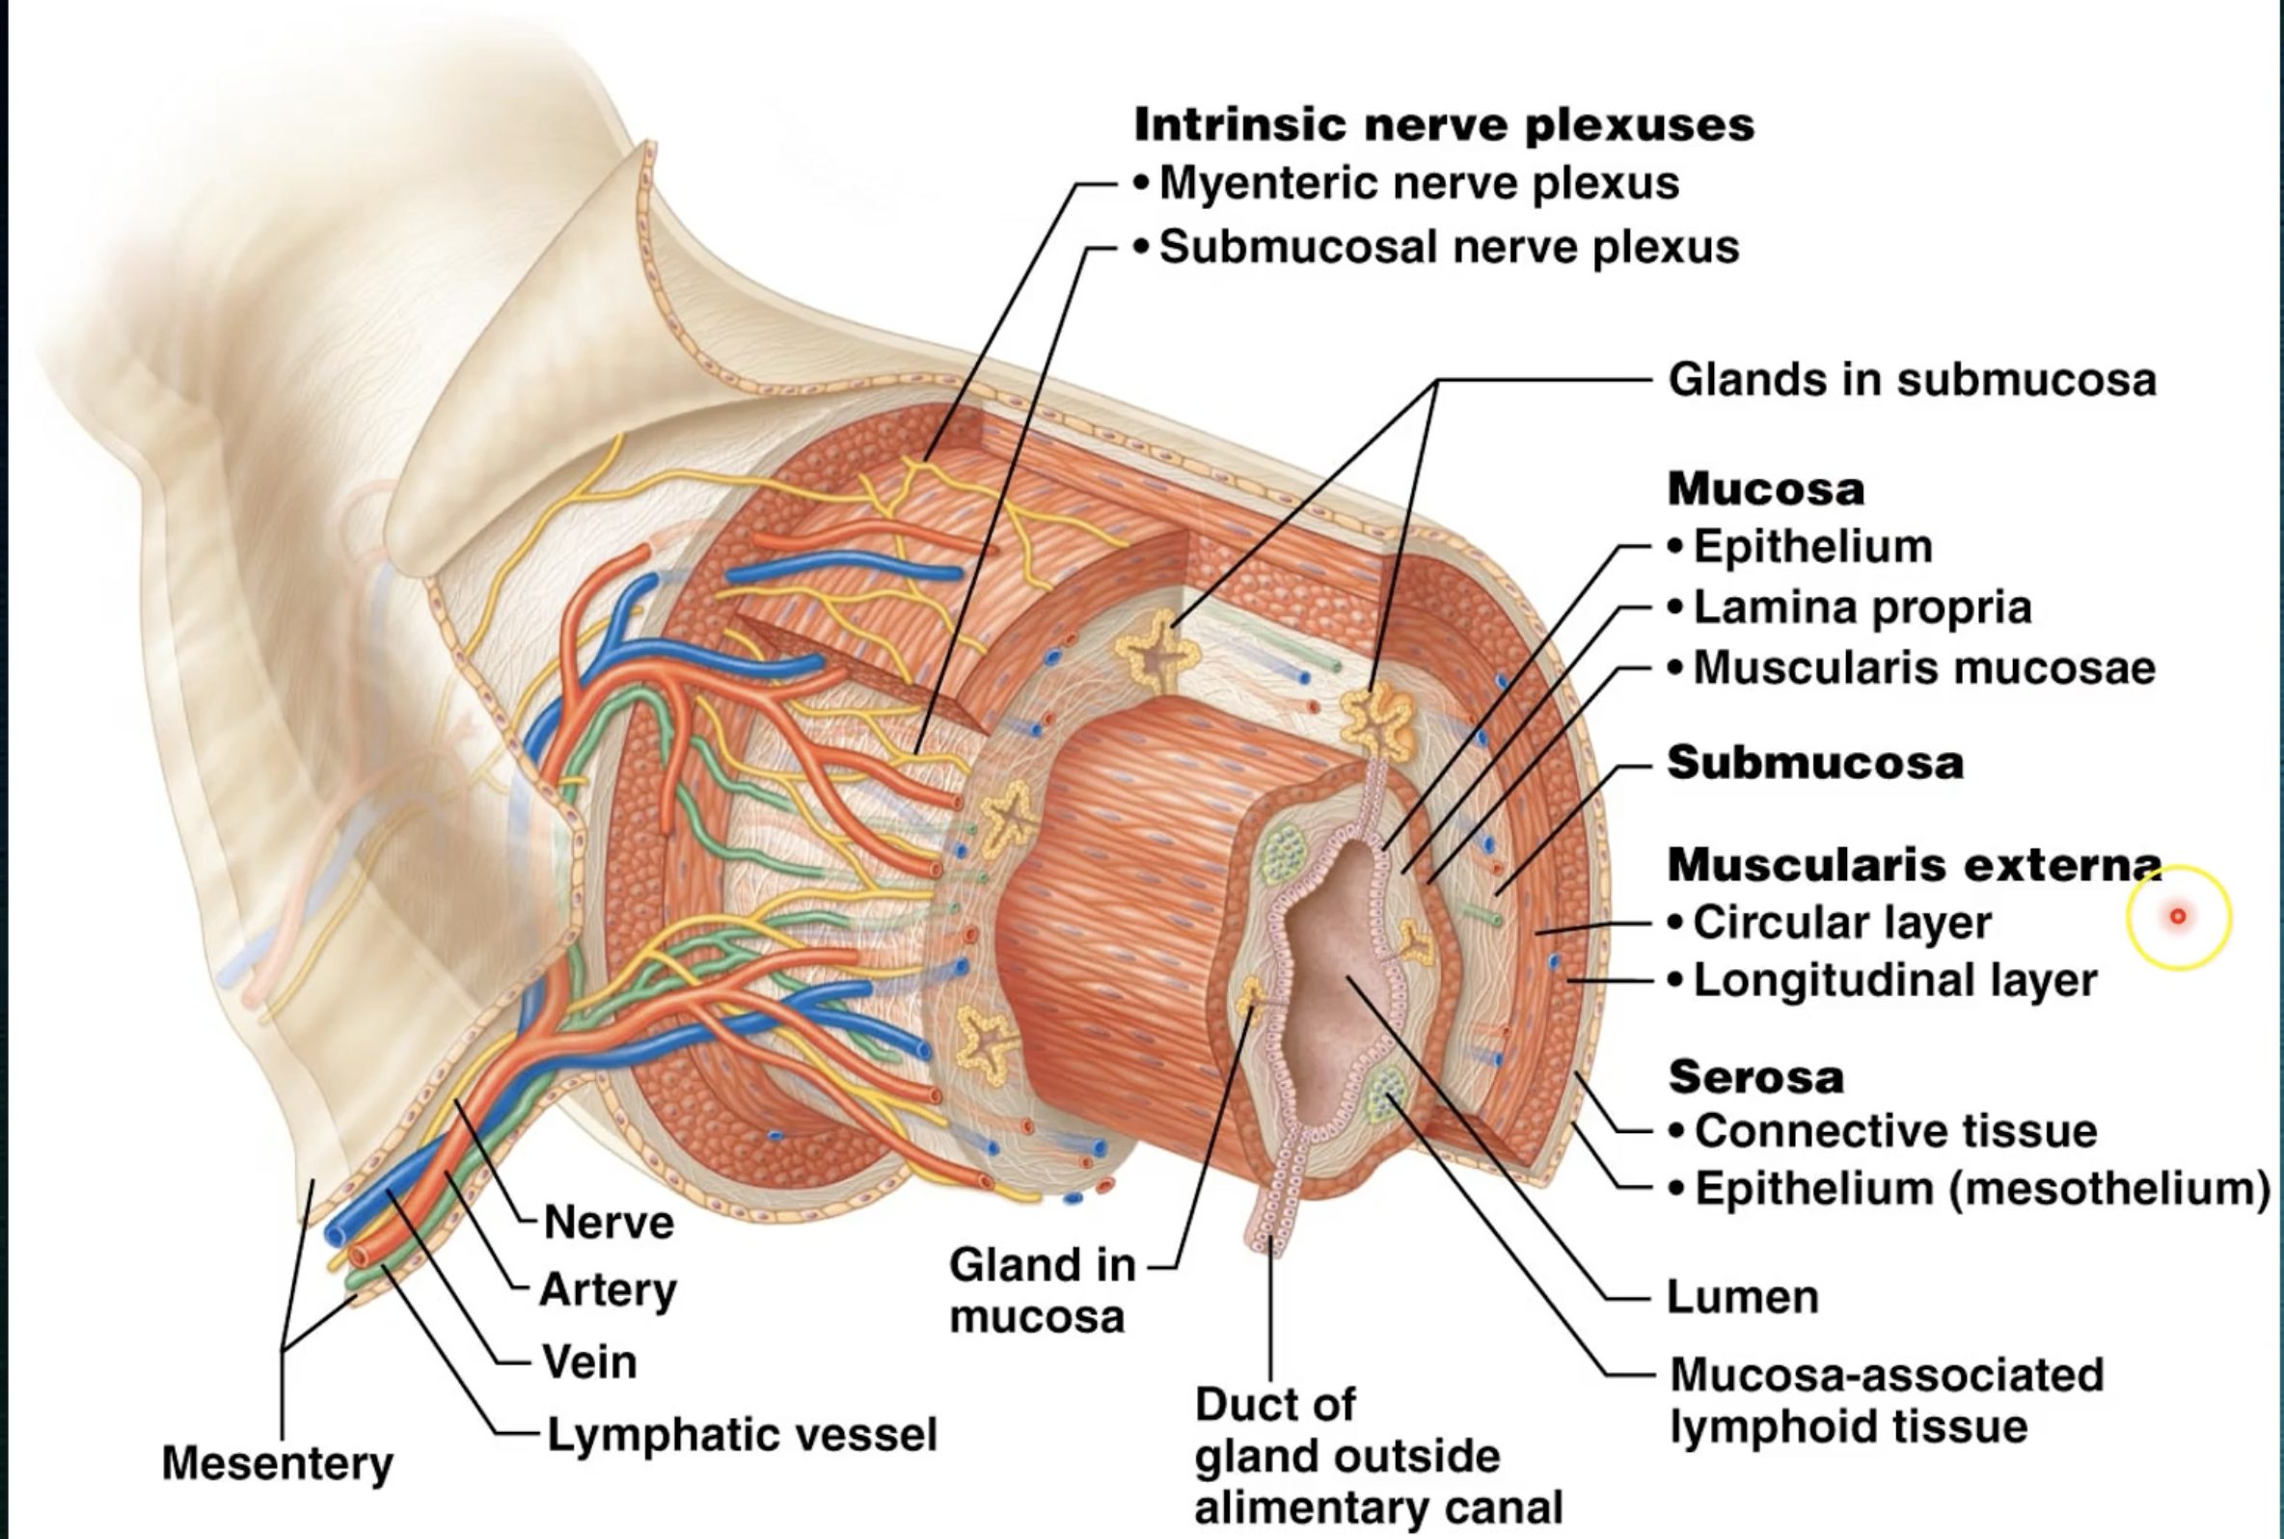
Histology part 3
4. Serosa
﻿The outermost layer, which is made up of the visceral peritoneum
﻿﻿Formed from areolar connective tissue covered with mesothelium (single layer of squamous epithelium) in most organs
Gross anatomy of GI tissue

Slide 13
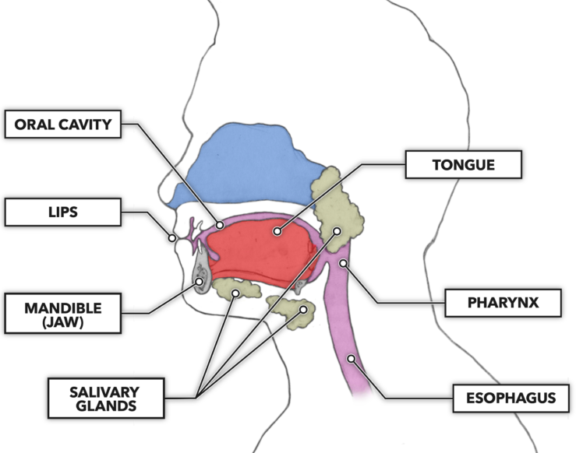
The Mouth

Slide 14
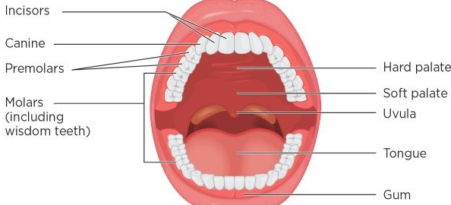
The Mouth
Buccal Cavity: This is another term for the mouth cavity, where the initial stages of digestion occur.
Divisions of the Palate:
Hard Palate: The bony front part of the roof of the mouth.
Soft Palate: The muscular back part of the roof of the mouth.
Tongue: A muscular organ that helps in manipulating food for chewing and swallowing; it also contains taste buds.
Salivary Glands: Glands that produce saliva, which wets food and contains the enzyme amylase to begin the digestion of starches.
Types of Teeth:
Incisors: For cutting food.
Canines: For tearing food.
Premolars and Molars: For grinding and crushing food.

Slide 15
The Mouth part 2
Contents of Saliva and Their Importance for Digestion:
Water: Saliva is primarily composed of water, which helps moisten food, making it easier to chew and swallow.
Enzymes:
Amylase: Begins the digestion of starches by breaking them down into simpler sugars.
Mucus: Lubricates the food, aiding in the formation of a bolus for easier swallowing.
Electrolytes: Such as sodium, potassium, and bicarbonate, which help maintain the pH balance in the mouth.
Antibacterial Compounds: Help control bacterial growth in the mouth.
Importance: Saliva initiates the digestive process, protects the oral cavity, and facilitates taste and swallowing.
Mastication: refers to the process of chewing, where food is broken down into smaller pieces by the teeth, increasing the surface area for enzymes to act upon during digestion.

Slide 16
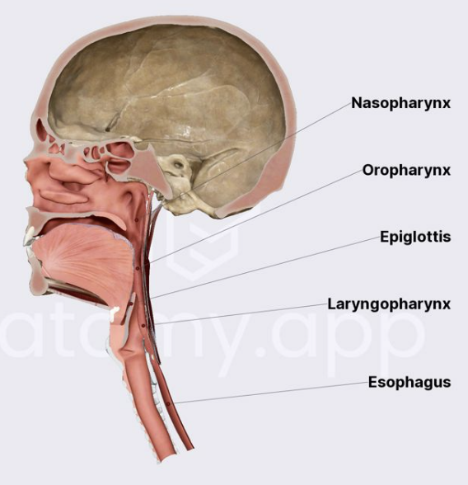
Pharynx and Esophagus
(Pharynx is a broad term for other pharynx’s, but you only need to know the Pharynx region)

Slide 17
Pharynx and Esophagus
Deglutition (Swallowing): This is the process of moving food from the mouth through the pharynx and into the esophagus. It involves:
Voluntary phase: The tongue pushes the bolus (chewed food mixed with saliva) to the back of the mouth.
Involuntary phase: The bolus enters the pharynx, triggering a reflex that moves it into the esophagus.
Peristalsis: This is an involuntary process that involves a series of wave-like muscle contractions. It moves food through the digestive tract, starting from the esophagus and continuing through the stomach, intestines, and beyond. In the esophagus, peristalsis ensures that the bolus is pushed down into the stomach.

Slide 18
Stomach

Slide 19
Stomach
Stomach Modifications:
Muscularis: The stomach's muscularis externa is unique because it has an extra layer of muscle. It consists of three layers:
Oblique layer (innermost) - unique to the stomach.
Circular layer (middle).
Longitudinal layer (outermost).
Mucosa: The mucosa is modified with a thick alkaline mucus barrier to protect against stomach acid. It also contains gastric pits leading to gastric glands.
Cells in Gastric Glands and Their Secretions:
Mucus Neck Cells: Secrete acidic mucus.
Parietal Cells: Secrete hydrochloric acid (HCl) and intrinsic factor.
Chief Cells: Secrete pepsinogen (converted to pepsin) and lipase.
Enteroendocrine Cells: Release hormones and paracrine molecules like gastrin.
Chemical Digestion in the Stomach:
Proteins: Denatured by HCl and digested by pepsin into amino acids.
Lipids: Begin digestion by lipases into fatty acids.

Slide 20
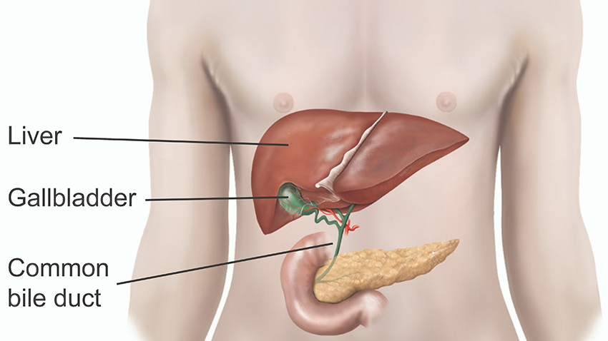
Liver and Gallblader

Slide 21
Liver
General Functions of the Liver:
**Metabolism Regulation:** The liver plays a key role in carbohydrate, protein, and fat metabolism.
**Detoxification:** It detoxifies various metabolites and drugs.
**Storage:** The liver stores vitamins and minerals, such as vitamin A, D, B12, iron, and copper.
**Synthesis of Proteins:** It produces essential proteins like albumin and clotting factors.
**Immune Function:** The liver contains immune cells that help fight infections.
Production of Bile:
Bile is produced by the liver.
Components of Bile:
Bile Salts: Derived from cholesterol, crucial for fat emulsification.
Bile Pigment: Mainly bilirubin, which gives bile its color.
Cholesterol, Triglycerides, Phospholipids, and Electrolytes: Other components found in bile.

Slide 22
Gallbladder
General Functions of the Gallbladder:
Storage of Bile: The gallbladder stores bile produced by the liver until it is needed for digestion.
Concentration of Bile: It concentrates bile by removing water and electrolytes, making it more effective for digestion.
Release of Bile: When food, especially fatty food, enters the small intestine, the gallbladder releases bile into the small intestine to aid in the digestion and absorption of fats.

Slide 23
Pancreas

Slide 24
Pancreatic secretory cells
**Pancreatic Acini:** - clusters of secretory cells that produce enzymes
These are clusters of cells in the pancreas that produce and secrete digestive enzymes.
The enzymes are secreted into small ducts that eventually lead to the main pancreatic duct.
Acinar cells are responsible for the exocrine function of the pancreas.
**Duct Cells:** -secrete to the duodenum via the main pancreatic duct
These cells line the pancreatic ducts and are responsible for secreting bicarbonate and water.
The bicarbonate helps to neutralize the acidic chyme that enters the small intestine from the stomach.
This creates an optimal pH environment for the digestive enzymes to function effectively.

Slide 25
Pancreas
Exocrine Function of the Pancreas:
The pancreas has an exocrine function that involves the secretion of digestive enzymes into the small intestine.
These enzymes are produced by acinar cells in the pancreas.
Contents of Pancreatic Juice:
Water
Bicarbonate: Helps neutralize stomach acid in the small intestine.
Digestive Enzymes:
Amylase: (for carbohydrates) breakdown into sugars.
Proteases: (for proteins): secreted in inactive form to prevent self-digestion
Lipases: (for lipids) break down into fatty acids and glycerol.
Nucleases: (for nucleic acids) Break down nucleic acids into nucleotides.

Slide 26
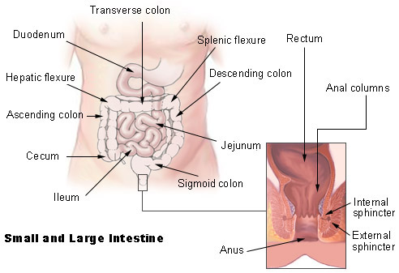
Small Intestine and Large Intestine

Slide 27
Small Intestine
How is it modified for nutrient absorption?
The small intestine has a large surface area to maximize absorption, achieved through:
Circular folds: Increase surface area and slow down chyme flow.
Villi: Finger-like projections that contain capillaries and lacteals for nutrient absorption.
Microvilli: Form the brush border with enzymes for the final digestion steps.
Identify the main types of cells found in villi and crypts and what they secrete:
Enterocytes: Absorb nutrients; secrete intestinal juice in crypts.
Goblet cells: secrete mucus.
Enteroendocrine cells: Secrete hormones like cholecystokinin.
Paneth cells: Secrete antimicrobial agents.
Stem cells: Replace other epithelial cells as they die.
See next page for small intestine anatomy

Slide 28
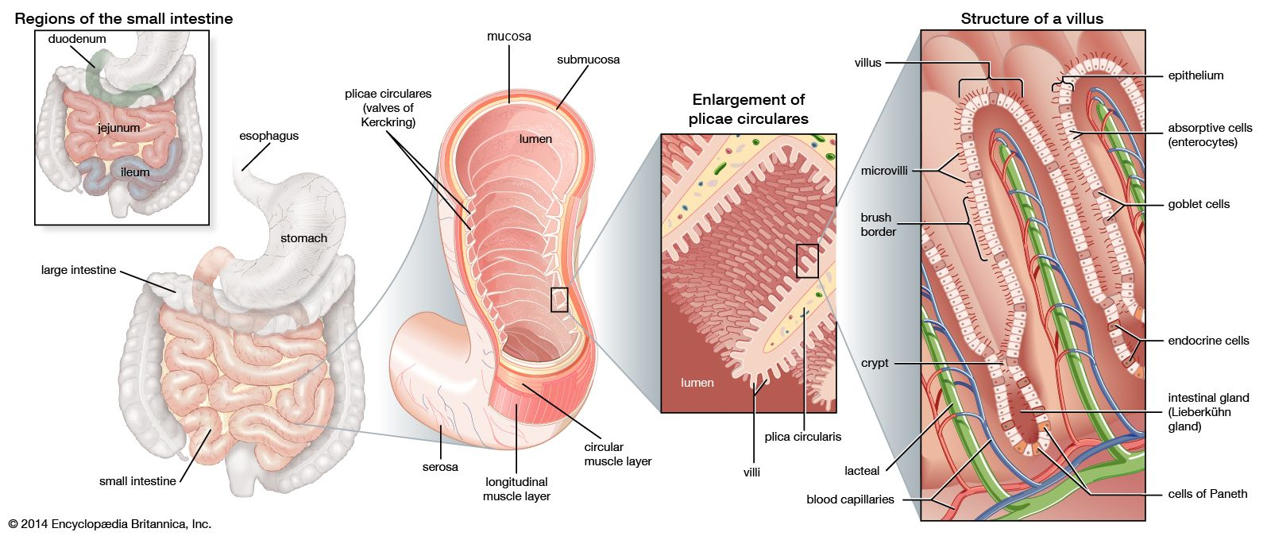
Small Intestine anatomy

Slide 29
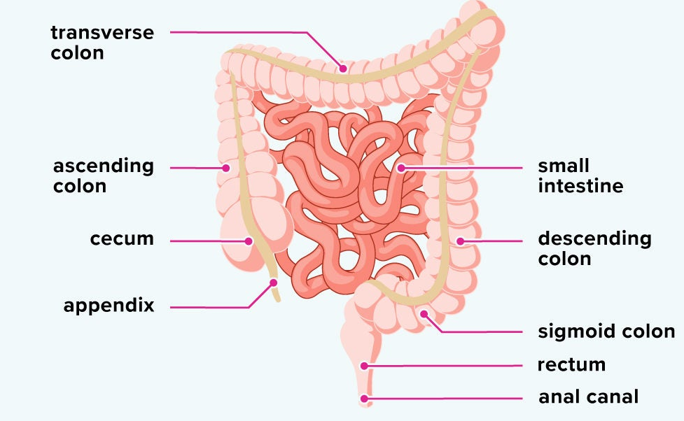
Large intestine
The subdivisions:
Cecum
Colon (ascending, transverse, descending, sigmoid)
Rectum
Anal canal
The digestive processes in the large intestine:
Absorption of water and electrolytes.
Formation and storage of feces.
Fermentation of indigestible food by gut bacteria.

Slide 30
Take away pt. 1
Digestive system • Identify the general functions and divisions • Describe the six essential activities involved with the digestive process • Be able to define peritoneum and the related terms • Differentiate between the four layers of tissue that makeup the GI tract and describe their general functions o Mucosa, submucosa, muscularis externa, and serosa • Mouth o Identify general terms and structures ▪ Buccal cavity, divisions of the palate, tongue, salivary glands, types of teeth o Know the contents of saliva and why they are important for digestion o Know what mastication means • Pharynx and esophagus o Know what is involved with deglutition o Know what peristalsis means • Stomach o How is the muscularis and mucosa modified? o Recognize the cells that are within gastric glands and what they secrete o What is chemically digested here? • Liver o Know the general functions o Know what produces bile and what bile contains

Slide 31
Take away
• Pancreas o Know the exocrine function and what cells are involved o Identify the contents of pancreatic juice ▪ What digestive enzymes are produce and what do they break down • Small intestine How is it modified for nutrient absorption? Identify the main types of cells found in villi and crypts and what they secrete•.
-Large intestine o Identify the subdivisions o Recognize the digestive processes in the large intestine Metabolism • Identify the 6 categories of nutrients • What is anabolism? Catabolism? • Define enzyme. Why are they important? • What is adenosine triphosphate (ATP)? • How many ATP are produced from Glycolysis per glucose molecule? • How many ATP are produced from Glycolysis, Kreb’s Cycle, and electron transport per glucose molecule? • Why do we breathe in O2? Where does the CO2 come from? • Nutrient absorption o Absorptive state vs. Post absorptive state • Recognize the factors which influence the metabolic rate.

